Slide 1
Toxicity Detection in Comments/Texts
AI Mini Project
-Simran Kucheria

Slide 2
Problem
Communication online can be difficult. The threat of abuse and harassment online is at an all time high due to the anonymity the internet provides.Platforms struggle to effectively facilitate conversations and leads to comments that are unsavoury in nature being passed around.

Slide 3
What the project is about
The problem can be classified as a NLP(Natural Language Processing) problem. So I set out to create a Deep Learning model that trains on comments and learns to identify the varying categories of toxicity.
The categories I focused on Toxic, Severe_Toxic, Obscene, Threat, Insult, Identity_Hate.
The model outputs probabilites for each of these categories and is about 98.2% accurate(when tested on a test set)

Slide 4
Additional Details
The training test and test set were sourced from Kaggle.
Using the model that was obtained after training, I created a streamlit app for easier data entry and presentation. The prediction gets represented as a barchart.
File used to create model is included along with project ‘Training.ipynb’
Github Repo: https://www.github.com/SimranKucheria/ToxicityDetectionAi

Slide 5
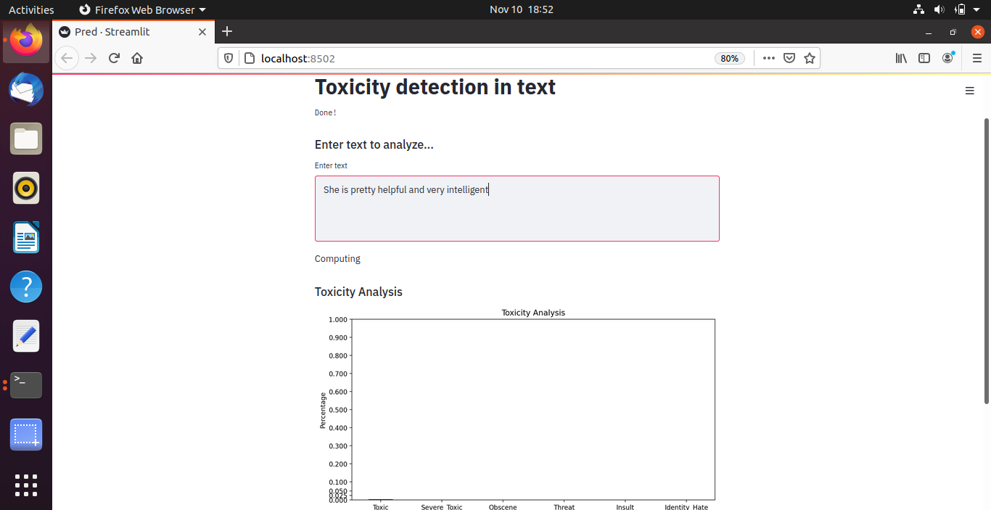
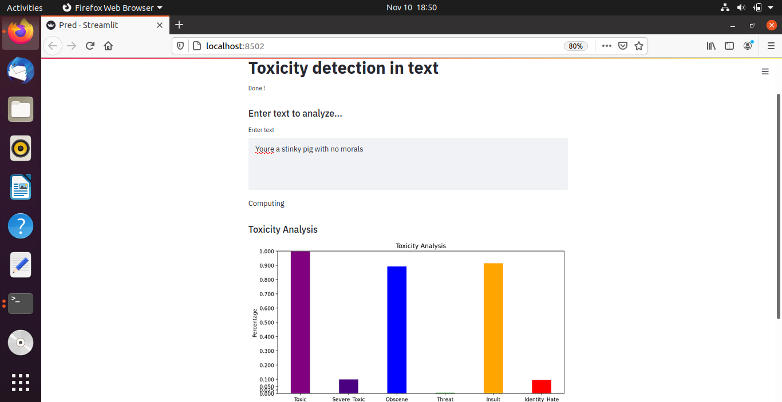
Sample

Slide 6
Thank you!

